Slide 1
Operating Systems
Operating System Architecture
Dr. Cristina Muntean
Cristina.Muntean@ncirl.ie

Slide 2
Topics covered in this lecture
Unix/Linux OS Architecture
Windows NT Architecture (e.g. 2000/XP/Windows 7)

Slide 3
3.1 Linux System Architecture
The Linux operating system is composed of four major subsystems
A set of applications in use: E.g. Web browser
word-processing application,
User Applications
O/S Services
Unix Kernel
Services that are part of the OS
(windowing system, command shell, etc.);
Programming interface to the kernel
(compiler tool, library) is also included here.
Hardware Controllers

Slide 4
3.1 Linux System Architecture (cont)
User Applications
O/S Services
The kernel abstracts and mediates access to
the hardware resources, including the CPU.
The main area of interest in this lecture
Unix Kernel
Hardware Controllers
It is comprised of all the possible physical devices in a Linux installation
Example: CPU, memory hardware, hard disks, network hardware, etc.
Each subsystem layer can only communicate with the subsystem layers that are immediately adjacent to it

Slide 5
3.1 Linux System Architecture (cont)
User Applications
O/S Services
Unix Kernel
Hardware Controllers
The dependencies between subsystems are from the top down
Subsystem layers pictured near the top depend on lower layers
Subsystems nearer the bottom do not depend on higher layers.

Slide 6
3.1.1 Linux Kernel
User Applications
O/S Services
Unix Kernel
Hardware Controllers
Linux kernel presents a virtual machine interface to user processes (apps).
=> processes do not need any knowledge of what physical hardware is installed on the computer
Linux kernel abstracts all hardware into a consistent virtual interface.
Linux supports multi-tasking in a manner that is transparent to user processes
Each process acts as though it is the only process on the computer, with exclusive use of all hardware resources.
The kernel actually runs several processes concurrently
The kernel is responsible for mediating access to hardware resources so that each process has fair access while inter-process security is maintained

Slide 7
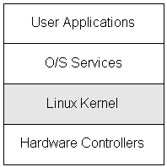
3.1.2 Overview of the Kernel Structure
Linux Kernel is composed of five main subsystems:
Process Scheduler (SCHED)
Memory Manager (MM)
Virtual File System (VFS)
Network Interface (NET)
Inter-Process Communication (IPC)
Linux KERNEL
Process Scheduler (SCHED)
Memory Management (MM)
Virtual File System (VFS)
Network Interface (NET)
Inter-Process Comm. (IPC))

Slide 8
3.1.2 Overview of the Kernel Structure
Process Scheduler (SCHED)
GOAL: To control access to the computer's CPU(s). This includes not only access by user processes, but also access for other kernel subsystems
The scheduler enforces a policy that ensures that:
processes will have fair access to the CPU
necessary hardware actions are performed by the kernel on time.
KERNEL
Process Scheduler (SCHED)
Memory Management (MM)
Virtual File System (VFS)
Network Interface (NET)
Inter-Process Comm. (IPC))

Slide 9
3.1.2 Overview of the Kernel Structure
Memory Manager (MM)
GOAL: responsible for controlling process access to the hardware memory resources.
Permits multiple processes to share the main memory
Supports the virtual memory (VM)
VM supports processes that use more memory than is available.
Unused memory info is swapped out to persistent storage using the file system. Later on it is swapped back in the memory when needed.
KERNEL
Process Scheduler (SCHED)
Memory Management (MM)
Virtual File System (VFS)
Network Interface (NET)
Inter-Process Comm. (IPC))

Slide 10
3.1.2 Overview of the Kernel Structure
Virtual File System (VFS)
GOAL: to present a consistent view of data as stored on hardware
devices
to abstract the details of the variety of hardware devices.
Presents a common file interface to all devices.
Supports several file system formats that are compatible with other operating systems
KERNEL
Process Scheduler (SCHED)
Memory Management (MM)
Virtual File System (VFS)
Network Interface (NET)
Inter-Process Comm. (IPC))

Slide 11
3.1.2 Overview of the Kernel Structure
Network Interface (NET)
GOAL: allows Linux system to connect to other systems over a network.
Provides access to several networking standards and to a variety of network hardware.
Abstracts both network-related hardware devices and network protocols so that processes can access the network without knowing what physical devices or protocol is being used
KERNEL
Process Scheduler (SCHED)
Memory Management (MM)
Virtual File System (VFS)
Network Interface (NET)
Inter-Process Comm. (IPC))

Slide 12
3.1.2 Overview of the Kernel Structure
Inter-Process Communication (IPC) subsystem
GOAL: to allow processes to exchange information if required
Supports several mechanisms (e.g. pipe, signals, common shared memory area) for process-to-process communication on a single Linux system
KERNEL
Process Scheduler (SCHED)
Memory Management (MM)
Virtual File System (VFS)
Network Interface (NET)
Inter-Process Comm. (IPC))

Slide 13
3.1.3 Kernel’s Data Structures
KERNEL
Process Scheduler (SCHED)
Memory Management (MM)
Virtual File System (VFS)
Network Interface (NET)
Inter-Process Comm. (IPC))
Process Scheduler: Task List data structure
The Process Scheduler maintains a block of data for each process that is active.
These blocks of data are stored in a linked list called task list
The Process Scheduler always maintains a current pointer that indicates the current process that is active.
Pointer to the active process
P1
P2
Pn
. . .
Block of Data used for P1

Slide 14
3.1.3 Kernel’s Data Structures
KERNEL
Process Scheduler (SCHED)
Memory Management (MM)
Virtual File System (VFS)
Network Interface (NET)
Inter-Process Comm. (IPC))
Memory Manager: Memory Map data structure
a mapping of virtual memory to physical addresses on a per-process basis
additional information on how to fetch and replace particular memory sections (pages)
Virtual Memory

Slide 15
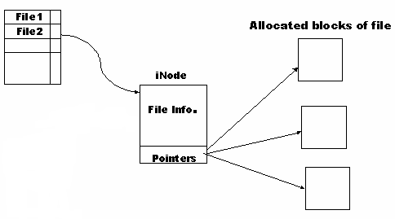
3.1.3 Kernel’s Data Structures
KERNEL
Process Scheduler (SCHED)
Memory Management (MM)
Virtual File System (VFS)
Network Interface (NET)
Virtual File System: Index – Nodes (i-nodes)
The Virtual File System uses i-nodes to represent files on a logical file system.
i-node data structure stores the mapping of file block numbers to physical device (e.g. HDD) addresses.
i-node data structure can be shared across processes if two processes have the same file open.
Inter-Process Comm. (IPC))

Slide 16
3.1.3 Kernel’s Data Structures
KERNEL
Process Scheduler (SCHED)
Memory Management (MM)
Virtual File System (VFS)
Network Interface (NET)
Network Interface: Sockets
Each network object is represented as a socket.
Sockets are associated with processes that communicate over the network
Sockets can be share amongst processes
Inter-Process Comm. (IPC))

Slide 17
3.1.3 Kernel’s Data Structures
KERNEL
Process Scheduler (SCHED)
Memory Management (MM)
Virtual File System (VFS)
Network Interface (NET)
Data Structures Connection
All the data structures are rooted at the task list of the process scheduler.
Each process on the system has a data structure containing
a pointer to its memory mapping information
pointers to the i-nodes representing all of the opened files.
Pointers to the sockets used that represent all opened network connections associated with the process
Inter-Process Comm. (IPC))

Slide 18
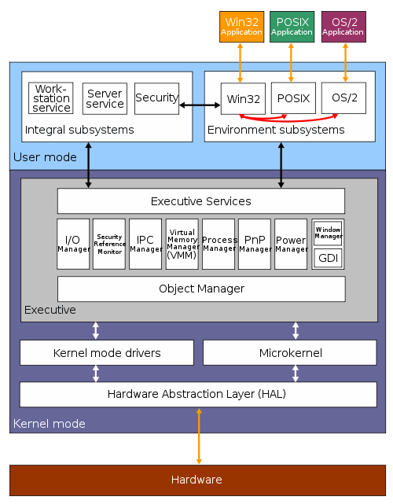
3.2 Windows NT Architecture (2000/XP)
Windows NT operating system family's architecture consists of two main layers:
User Mode
Kernel Mode

Slide 19
3.2 Windows NT Architecture (2000/XP)
The architecture’ s layers : User Mode Layer
This is the environment in which user applications (E.g. MS Word, IE) and environment subsystems are executed.
Programs and subsystems in user mode are limited in terms of what system resources they have access to.
Two subsystems make up the user mode:
Environment Subsystems
Integral Subsystems

Slide 20
3.2 Windows NT Architecture (2000/XP)
The architecture’ s layers : User Mode Layer
Environment Subsystems
Designed to run applications written for different types of OS
Allow Windows to effectively act as if it were a different OS
There are three main environment subsystems:
Win32 subsystem - the native and primary subsystem for Windows NT.
OS/2 subsystem - Initially was scheduled to be the default and primary subsystem for Windows NT. But… a decision was made to give NT the Windows interface and to build it as the successor for the Windows platform=> the emphasis on OS/2 support was diminished.
POSIX subsystem - developed by the IEEE as a standard for use on UNIX systems. When a POSIX application runs on Windows NT, the POSIX subsystem is loaded

Slide 21
3.2 Windows NT Architecture (2000/XP)
The architecture’ s layers : User Mode Layer
Integral Subsystems
Provide important services to all applications, including client, server, and security services
It handles the logon requests and initiates logon authentication
It works with the Security Reference Monitor in the Kernel Mode to verify the password.
Grants or denies access to user accounts based on resource permissions

Slide 22
3.2 Windows NT Architecture (2000/XP)
The architecture’ s layers : Kernel Mode Layer
Consists of
Programs that help software running on our system use the computer’s hardware
Device drivers (software interfaces to hardware)
It has full access to the hardware and system resources of the computer and runs in a protected memory area.
It controls access to scheduling apps, memory management and the interaction with hardware
The kernel mode stops User Mode applications from accessing critical areas of the operating system that they should not have access.
It has execution priority over all User Mode applications

Slide 23
3.2 Windows NT Architecture (2000/XP)
Kernel Mode Layer consists of
1. Executive - the interface between the Kernel and the User Mode subsystems.
It provides services to support requests from the User Mode subsystems
The executive is divided into several subsystems:
I/O Manager - allows devices to communicate with user-mode subsystems
Object Manager - special executive subsystem that all other executive subsystems, especially system calls, must pass through to gain access to Windows NT resources
Security Ref. Monitor - Enforces security policies on the local computer , guards operating system resources
Local Procedure Call (LPC) - provides inter-process communication ports
Memory Manager – manages virtual memory, controls memory protection and paging of memory in and out of physical memory to secondary storage.

Slide 24
3.2 Windows NT Architecture (2000/XP)
Kernel Mode Layer consists of
1. Executive - the interface between the Kernel and the User Mode subsystems.
It provides services to support requests from the User Mode subsystems
The executive is divided into several subsystems:
Process Manager - Creates and terminates processes
Plug and play manager (PnP)- Determines which drivers are required for a device and loads them. Sends notifications for device changes on the system
Power Manager - Can put CPU to sleep when system is idle to reduce power consumption
GDI – Graphical Device Interface - responsible for tasks such as drawing lines and curves, rendering fonts
Object Manager is an executive subsystem that all other executive subsystems must pass through to gain access to the resources

Slide 25
3.2 Windows NT Architecture (2000/XP)

Slide 26
3.2 Windows NT Architecture (2000/XP)
Kernel Mode Layer consists of
2. Microkernel - the nucleus of the Operating system.
It schedules all system activities for optimum performance.
It provides building-blocks for all the Executive Services running in the Kernel
It is also responsible for initializing device drivers at bootup that are necessary to get the operating system up and running
3. Hardware Abstraction Layer (HAL)
a layer between the physical hardware of the computer and the rest of the operating system
The HAL hides the individual differences between various types of hardware from the Operating System.
The HAL can only be accessed by components of the Executive, and is never called directly by User Mode programs.
4. Kernel Mode drivers
used by Windows OS to interact with the hardware devices

Slide 27
Learning Outcome
After this lecture you should have an understanding of the architecture of two Operating Systems: Linux and Windows
You should know the following:
Unix/Linux Architecture consists of 4 subsystems
Unix Kernel structure and the data structures used
Windows architecture consists of two layers
KERNEL
Process Scheduler (SCHED)
Memory Management (MM)
Virtual File System (VFS)
Network Interface (NET)
Inter-Process Comm. (IPC))

